Slide 1
Secure Instant Messaging System Design

Slide 2
ARCHITECTURE:
Server:
Authenticates client on login based on User’s password.
Stores public key of every client.
If User1 wants to talk to User2, Server provides the public key of User2 to User1.
Client:
Fetches public key of other users from Server
Communicates with other clients

Slide 3
Protocol Notations:
PKU1: Public key of User1
PKU2: Public key of User2
pass: Password of User1
g : generator
R1: Random number
R2: Random number
IP : IP address of source
sec: Secret know only by Server

Slide 4
Protocol that we would implement:

Slide 5
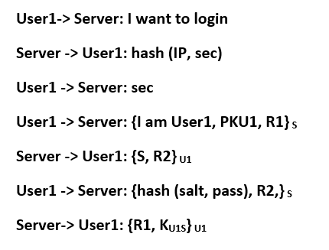
Protocol Phase 1: User authenticates to Server on login
Here server store the value of g, salt. computation of g^hash(salt, pass) and username.
Password verifier is g^hash(salt, pass) and it is indexed by the username.
When user initiates the connection it shares it’s public key which is stored by server for that session.
Here we will be doing proof of work by making user1 calculate the secret which in turn will save us from DOS attack.
In the end server is storing a session key for user1 and also giving it to user1 for future communication.
Here we are doing this proof of work every time but in idle implementation we will start this mode only when we our system detects a heavy traffic.

Slide 6
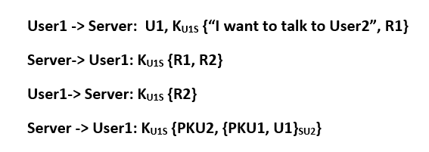
Protocol Phase 2: User1 requests public key of User2 from Server:
Server has a shared key with every user.
If client doesn’t receive a correct response to it’s challenge it doesn’t proceed far.
After the third step, if server receives the correct response to its challenge, it continues to the next step, else breaks connection.
Server provides user1 with a token that it can use to talk to user2 i.e. {PKU1, U1}su2 here su2 is the secret key between server and user2.

Slide 7
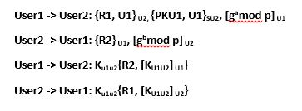
Protocol Phase 3: User1 connects to User2 using token generated by Server
User1 initiates communication with user2 by using token generated by server.
After the second step, user1 and user2 are able to generate a shared session key.
Both user verifies the shared key they have by sending them over and also signing them by their private key.

Slide 8
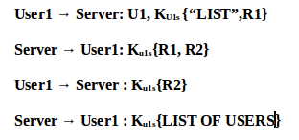
List command(OLD in PS4):
Here the steps are similar to phase 2 where User ask for list of current login users.
In second packet server authenticates itself than sends challenge for user.
Once user authenticates itself server sends the list of user.

Slide 9
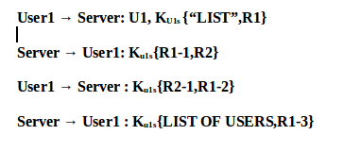
List command(New):
Here the steps are similar to old design where User ask for list of current login users.
The only difference between them is here we are decrementing nonce by one before sending them.

Slide 10
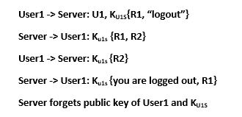
Logout command:
Here user1 sends a logout request and a challenge.
Than server authenticates itself and also sends it’s challenge to server.
Once it authenticates the server the server deletes the public key and session key. It also send the confirmation. In our implementation we will wait for reply for some seconds and if we don’t get the reply from server we will warn user about logout process not complete but will shut down the client.
In ideal case the client will initiate the logout process again if that is the case.

